Slide 1

软件工程专业英语
计算机科学学院
School of Computer Science
Unit 9：Taking an Interview

Slide 2
Outline
Part 1, Dialogue: Interview
Part 2, Translating: Careers for Computer Professionals

Slide 3
Part 1, Dialogue: Interview
Main content
Kevin到Expansion公司进行面试
qualifications （能力）
education background （教育背景）
motivation（动机）
internship experience （实习经历）

Slide 4
(Kevin's application for a position as a programmer in the technical department of Expansion has been responded by the Human Resources Department of the company. Today he comes to the company for an interview.)
Mr. Smith: Good morning, thank you for applying for our opening positions. My name is Smith, the manager of Human Resources Department. What's your name, please?
Kevin: Good morning, Mr. Smith. My name is Kevin Li, and I am coming for the position as a programmer in the technical department.
apply for 申请
apply for post/job/position 申请职位、工作
apply for award/scholarship 申请奖励、奖学金
apply for major/school 申请专业、学校
Notes:
skeptical 英 [ˈskeptɪkl] 美 [ˈskeptɪkl] adj.怀疑的

Slide 5
Mr. Smith: Well, now I would like to talk with you regarding your qualifications for this interview. What can you tell me about yourself?
Kevin: I'm an active and responsible person, and will not give up even if I encounter numerous obstacles on the way to my goal. I like to work in a team, because I believe that it is important to share the opinions with each other to get the best results. I am very interested in the latest advancements in science and technology, and have a good theoretical background and hands-on capabilities. I love the IT industry and want to pursue an IT career.
Notes:
skeptical 英 [ˈskeptɪkl] 美 [ˈskeptɪkl] adj.怀疑的

Slide 6
Recruitment Info from Microsoft
Job Overview:
We are seeking smart, responsible, and energetic interns to join our Networking Research Group. In this position, you will be expected to learn both hardware and software knowledge and have more experience on networking system.
Research Intern
Position Type: Full time intern
Number: Several
Location: Beijing
Responsibilities and Duties:
A research intern is expected to contribute in many ways to the research project, typical responsibilities and duties include the following:
General
Handle one project independently
Summarize project results and monitor the project progress
Prepare progress reports and presentations, and attend project meetings
Write paper
Software
Design and implement next-generation networking security system
Use C language, python, etc. to implement high-efficient system component
Do the unit test and integration test
Hardware
Design and implement next-generation hardware-based system
Use the Verilog to implement the hardware module
Write the code for OS driver and experiments
Do the simulation and onboard testing
Other duties and responsibilities may be assigned by individual researchers.
Qualifications:
Software:
Educational background: CS, B.S/Master/Ph.D. candidate.
Basic Networking Background, ML/Storage/GPU/OS Driver experience is preferred
Good programming skills in C / C++
Good communication skills and excellent teamwork
Familiar with both Windows and Linux (Ubuntu, CentOS, etc.)
Hardware:
Educational background: CS/EE.
Familiar with Analog/Digital circuits implementation.
Familiar with FPGA EDA tools, such as ISE/Quartus/ModelSim, etc.al.
Experience of developing FPGA related projects is preferred.
Knowledge of Network/Computer Architecture is preferred.
Working time requirement
Full-time Intern, At least 3 months, preferable 6+ months

Slide 7
Mr. Smith: Can you talk about your education background?
Kevin: I have just graduated from School of Software, BeiHang University in July of 2013, and obtained a bachelor degree in software engineering.
Mr. Smith: Why do you apply for a job at our company?
Kevin: As we know, Expansion company is one of the longest established and leading software outsourcing products, services and solutions providers in China, but also has a global presence. So I believe that working here can help me grow professionally. I also think I can contribute to the development of the company.
Notes:
skeptical 英 [ˈskeptɪkl] 美 [ˈskeptɪkl] adj.怀疑的

Slide 8
Mr. Smith: Have you ever done an internship that helped to prepare you for this type of work?
Kevin: Yes. I have participated in several practical projects as a programmer in the Lab which is built by our school's cooperating with Microsoft during my undergraduate study. I participated in a hotel management information system for Four Seasons Hotel as a project manager and a management information system for the financial department of Giant company. Besides, regarding my internship, I have done a research and analysis about the global software market and completed a business report for a domestic leading IT company in English. All of the above are very valuable internship experience for me to prepare for this work, I think.
Notes:
skeptical 英 [ˈskeptɪkl] 美 [ˈskeptɪkl] adj.怀疑的

Slide 9
Mr. Smith: OK, that sounds great! What else do you want to know about your work?
Kevin: I want to know what other qualifications you consider necessary for this position?
Mr. Smith: Well, as I know, sometimes the workload of developing software may be really very heavy, so the person who is in charge of it may have to be under much pressure and must be energetic and capable.
Kevin: Yes, I agree with you. On this point, my internship experience has made me used to this kind of work environment.
Mr. Smith: OK, thank you for your interest in our company. If we decide to bring you onto our team, you will receive an E-mail from us within five working days.
Kevin: Thank you very much. I'm looking forward to hearing from you.
1. Can you work under pressure?
你能在压力下工作吗？
2. He was under pressure to resign and was about to be sidelined.
他承受着被迫辞职的压力，很快就要被排挤出去了。
under pressure
在压力下
Notes:
skeptical 英 [ˈskeptɪkl] 美 [ˈskeptɪkl] adj.怀疑的

Slide 10
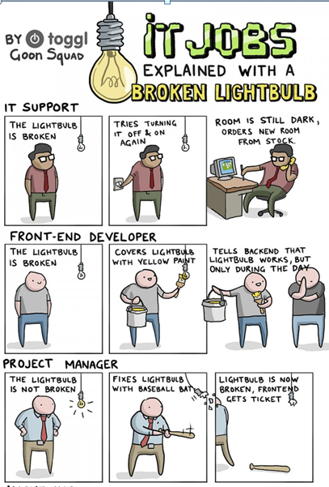
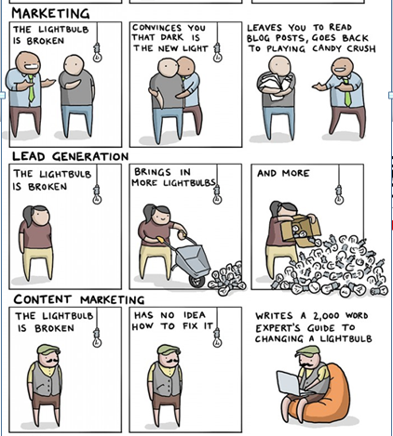
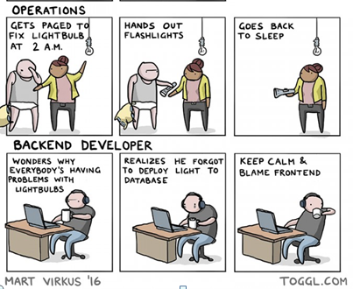
IT Jobs Explained With a Broken Lightbulb
销路拓展

Slide 11
Outline
Part 1, Dialogue: Interview
Part 2, Translating: Careers for Computer Professionals

Slide 12
The 1st paragraph
In 1999, the U.S. Congress crafted an amendment to the Fair Labor Standards Act that essentially defines a computer professional as any person whose primary occupation involves the design, configuration, analysis, development, modification, testing, or security of computer hardware or software.
craft
n.手艺; 工艺; 技巧; 技能; 技艺; 诡计; 手腕; 骗术
v. (尤指用手工) 精心制作、策划
1. All kinds of traditional craft industries are preserved here.
这里保留着各种各样的传统手工业。
2. All the furniture is crafted from natural materials.
所有的家具均采用天然材料精心制作而成。

Slide 13
The 2nd paragraph
Many computer professionals work in an Information System department—the wing of a business or organization responsible for computer, data, software, and support services. An IS department is also responsible for prioritizing an organization's information needs, modifying old systems as necessary, and creating new systems. Most IS department are headed by a chief information officer (CIO), or director. The CIO heads a hierarchy of computer professionals, who might be organized as in Figure I.
prioritize [praɪˈɔːrətaɪz]
v. 按重要性排列; 划分优先顺序; 优先处理
1. You should make a list of all the jobs you have to do and prioritize them.
你应该把所有必须做的事都列出来，并按轻重缓急排个顺序。
2. Assess and prioritize various SOA initiatives. 评估和优先安排各种SOA活动。
head v. 朝(某方向)行进; 领导; 主管; 位于排行之首; 排在前头
1. Can you forecast where the economy is heading? 你能预测经济的发展方向吗？
2. She has been appointed to head the research team. 她受命领导研究小组。
3. Italy heads the table after two games. 两场比赛之后意大利队排名榜首。
4. The chapter was headed ‘My Early Life’. 这一章的标题是“我的早年生活”。

Slide 14
The 3rd paragraph
The following descriptions highlight typical responsibilities and skills for various IS department jobs: A systems analyst investigates the requirements of a business or organization, its employees, and its customers in order to plan and implement new or improved computer services. This job requires the ability to identify problems and research technical solutions. Good communications skills are essential for interacting with managers and other employees.

Slide 15
The 4th paragraph
A computer programmer (sometimes described as a programmer/analyst) designs, codes, and tests computer programs. In addition, programmers modify existing programs to meet new requirements or eliminate [ɪˈlɪmɪneɪt] bugs. Computer programming requires concentration and a good memory for the countless details that pertain to a programming project.
pertain to 属于; 适合; 关于; 有关; 附属
1. The following counters pertain to network send and receive operations.
下列计数器与网络发送和接收操作有关。
2. The first article in the series defined the characteristics and technologies that pertain to Web 2.0.
本系列的第一篇文章定义了Web2.0所具有的特征和技术。
3. However, this technology does pertain to a different target audience of decision makers.
然而，这项技术却很适合决策者的不同对象。

Slide 16
The 5th paragraph
A security specialist analyses a computer system's vulnerability to threats from viruses, worms, unauthorized access, and physical damage. Security specialists install and configure firewalls and antivirus software. They also work with management and employees to develop policies and procedures to protect computer equipment and data. A security specialist must have wide-ranging knowledge of computers as well as communications protocols that can be applied for a quick resolution to any crisis that occurs.
vulnerability [ˌvʌlnərə'bɪləti] n. 弱点; 脆弱性; 易伤性; 可捕性
1. As in the SQL injections, source code analysis is the only real way to eliminate the vulnerability.
和SQL注入中一样，源代码分析是消除漏洞的唯一真实方法。
2. All of these attacks and many others exploited a vulnerability called a buffer overflow.
所有这些攻击――以及其他许多攻击，都利用了一个称做为缓冲区溢出的程序缺陷。

Slide 17
The 6th ~7th paragraphs
A database administrator analyzes a company's data to determine the most effective way to collect and store it. Database administrators create databases, data entry forms, and reports. They also define backup procedures, provide access to authorized users, and supervise the day-to-day use of databases.
A network specialist/administrator plans, installs, and maintains one or more local area networks. These specialists also provide network accounts and access rights to approved users. They troubleshoot connectivity problems and respond to requests from the network's users for new software. Network specialists/administrators might be responsible for maintaining the security of a network, plus they often pick up Webmaster duties to maintain an organization's Web site.

Slide 18
The 8th ~10th paragraphs
A computer operator typically works with minicomputers, mainframes, and supercomputers. Computer operators monitor computer performance, install software patches and upgrades, perform backups and restore data as necessary.
A technical support specialist troubleshoots hardware and software problems. Good interpersonal skills and patience are required for this job.
A Web site designer creates, tests, posts, and modifies Web pages. A good sense of design and artistic talent are required for this job, along with an understanding of how people use graphical user interfaces. Familiarity [fəˌmɪliˈærəti] with Web tools, such as HTML, XML, JavaScript, and ActiveX, is becoming more important for this job, as is knowledge of computer programming and database management.

Slide 19
The 11th paragraph
A technical writer creates documentation for large programming projects and writes the outline or printed user manuals that accompany computers, peripheral devices, and software. Some technical writers work for computer magazines, writing columns about the latest hardware products, software, and automated business solutions, Good writing and communications skills are valuable for this job, as is an ability to quickly learn how to use new computers and software. A computer salesperson, or sales rep, sells computers or IT services. Sales reps might pay personal visits to potential corporate customers or work at the order desk of a mail-order computer company. Sales reps‘starting salaries tend to be low but are usually supplemented by commissions [佣金、回扣]. Effective sales reps have good interpersonal skills, an ability to remember technical specifications, and an understanding of business problems and solutions.

Slide 20
The 12th ~15th paragraphs
A quality assurance specialist participates in alpha and beta test cycles of software, looking for bugs or other usability problems. This job title sometimes refers to assembly-line workers who examine and test chips, circuit boards, computers, and peripheral devices. An effective QA specialist has a good eye for detail and a passion for perfection.
A computer engineer designs and tests new hardware products, such as computer chips, circuit boards, computers, and peripheral devices.
A manufacturing technician participates in the fabrication of computer chips, circuit boards, system units, or peripheral devices. Some of these jobs require basic screwdriver [螺丝刀] skills, whereas others require special training in microlithography.
The Information Technology Association of America (ITAA) categorizes IT jobs into eight clusters. Sample job titles are listed here:
lithography [lɪˈθɒɡrəfi] n.平版印刷术

Slide 21
The 16th ~18th paragraphs
Database Administration and Development: Database Administrator, Database Analyst, Database Developer, Database Manager, Database Security Expert, DSS (Decision Support Services), and Knowledge Architect.
Digital Media: 2-D/3-D Artist, Animator, Audio/Video Engineer, Designer, Media Specialist, Media/Instructional Designer, Multimedia Author, Multimedia Authoring Specialist, Multimedia Developer, Multimedia Specialist, Producer, Streaming Media Specialist, and Virtual Reality Specialist.
Enterprise System Analysis and Integration: Application Integrator, Business Continuity Analyst, Cross-Enterprise Integrator, Data Systems Designer, Data Systems Manager, E-business Specialist, Information Systems, Architect, Information Systems Planner, Systems Analyst, Systems Architect, and Systems Integrator.
Network Design and Administration: Communications Analyst, Network Administrator, Network Analyst, Network Architect, Network Engineer, Network Manager, Network Operations Analyst, Network Security Analyst, Network Specialist, and Network Technician.

Slide 22
The 19th ~22th paragraphs
Programming/Software Engineering: Applications Analyst, Applications Engineer, Business Analyst, Computer Engineer, OS Designer/Engineer, OS Programmer/Analyst, Program Manager, Programmer, Programmer/Analyst, Software Applications Specialist, Software Architect, Software Design Engineer, Software Engineer, Software QA Specialist, and Software Tester.
Technical Support: Call Center Support Rep, Customer Liaison, Customer Service Rep, Customer Support Professional, Help Desk Specialist, Help Desk Technician, PC Support Specialist, PC Systems Coordinator, Product Support Engineer, Sales Support Technician, Technical Account Manager, Technical Support Engineer, and Technical Support Representative.
Technical Writing: Desktop Publisher, Document Specialist, Documentation Specialist, Editor, Electronic Publications Specialist, Electronic Publisher, Instructional Designer, Online Publisher, Technical Communicator, Technical Editor, Technical Publications Manager, Technical Writer.
Web Development and Administration: Web Administrator, Web Architect, Web Designer, Web Page Developer, Web Site Developer, Web Specialist, and Webmaster.
Liaison [ˈliːəzɑːn] 连音; 联络人; 连读; 联络; 联络者

Slide 23
Appendix：List of Various Job Titles
首席技术执行官 Chief Technology Officer
首席信息官 Chief Information Officer
技术总监 Technical Director 技术经理 Technical Manager
技术主管 Technical Supervisor 高级硬件工程师 Senior Hardware Engineer
硬件工程师 Hardware Engineer 高级软件工程师 Senior Software Engineer
软件工程师 Software Engineer
ERP技术开发 ERP Technology Development Staff
ERP应用支持工程师 ERP Application Support Engineer
ERP实施工程师/顾问 ERP Implementation Engineer/Consultant
系统集成工程师 System Integration Engineer
系统分析员 System Analyst 系统工程师 System Engineer
数据库工程师|管理员 Database Engineer/Administrator
计算机辅助设计工程师 Computer Aided Design Engineer
信息技术经理 IT Manager
信息技术主管 IT Supervisor
信息技术专员 IT Specialist

Slide 24
项目总监 Project Director 项目经理 Project Manager
项目主管 Project Supervisor 项目执行|协调人员 Project Specialist/Coordinator
技术支持经理 Technical Support Manager
技术支持主管 Technical Support Supervisor
技术支持工程师 Technical Support Engineer
计量工程师 Measure Engineer 标准化工程师 Standardization Engineer
品质经理 Quality Manager 品质主管 Quality Supervisor
品质工程师 Quality Engineer 系统测试 System Testing
软件测试工程师 Software Testing Engineer
硬件测试工程师 Hardware Testing Engineer
测试员 Test Engineer /Tester 技术文员|助理 Technical Clerk/Assistant
系统管理员|网络管理员 System Administrator/Network Administrator
程序员 Programmer UI设计师 UI Developer/UI Designer
UI设计顾问 UI Design Consultant 需求工程师 Demand engineer
系统架构设计师 System Architect
仿真应用工程师 CAE Engineer(Computer Aided Engineering)
嵌入式硬件开发 Embedded hardware Development

Slide 25
互联网软件开发工程师 Internet Software Engineer
多媒体/游戏开发工程师 Multimedia/Game Development Engineer
网站营运经理 Web Operations Manager
网站营运主管 Web Operations Supervisor
网站营运专员 Web Operations Specialist
网络工程师 Web Engineer
网站策划 Website Designer
网站编辑 Website Editor
网页设计/制作 Web Designer/Production
网络信息安全工程师 Information Security Engineer
网络架构设计师 Network Architect Designer
网站维护工程师 Website Maintenance Engineer

